Slide 1
HW04

Slide 2
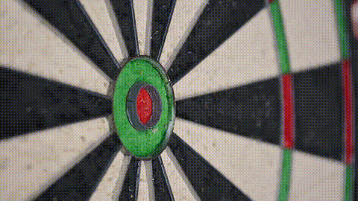
1. 目標
Notes:
https://cdn.pixabay.com/video/2018/11/23/19512-302628010_large.mp4

Slide 3

2. 阻礙
Notes:
https://cdn.pixabay.com/video/2020/12/10/58846-489663384_large.mp4

Slide 4

3. 努力
Notes:
https://cdn.pixabay.com/video/2017/03/08/8256-207598612_large.mp4

Slide 5

4. 結果
Notes:
https://cdn.pixabay.com/video/2022/08/01/126334-735976704_large.mp4

Slide 6

5. 意外
Notes:
https://cdn.pixabay.com/video/2017/08/10/11285-229221014_large.mp4

Slide 7

6. 轉彎
Notes:
https://cdn.pixabay.com/video/2023/11/02/187612-880737125_large.mp4

Slide 8

7. 結局
Notes:
https://cdn.pixabay.com/video/2021/02/16/65390-514139029_large.mp4

